Slide 1
INVENTORY MANAGEMENT PROJECT
Kavearhasi .v

Slide 2
OBJECTIVE
The objective of this inventory management system is to accurately track product quantities, providing a clear and up-to-date view of available stock. It manages stock movements by recording incoming and outgoing transactions, ensuring that all inventory changes are captured in real-time. Additionally, the system generates Excel reports to offer detailed insights into product movement history, supporting better decision-making. By improving visibility into inventory levels, this system aims to streamline inventory handling and support efficient business operations.

Slide 3
FEATURES
Keep track of products and their quantities.
Manage stock movements (incoming and outgoing).
Generate Excel reports on product movements.
Manages the warehouse

Slide 4
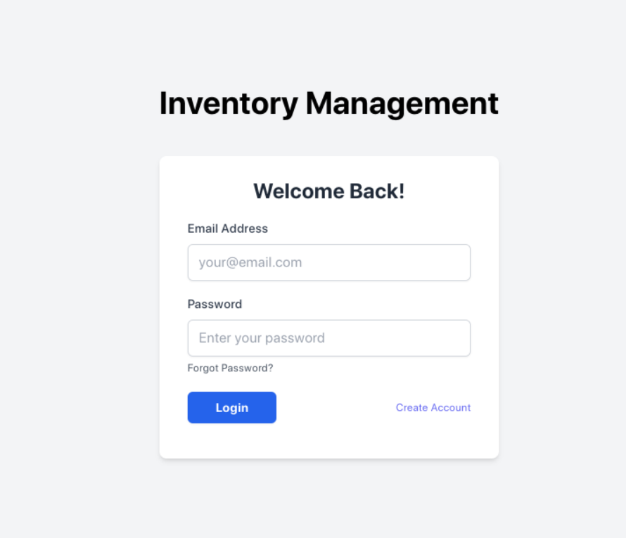
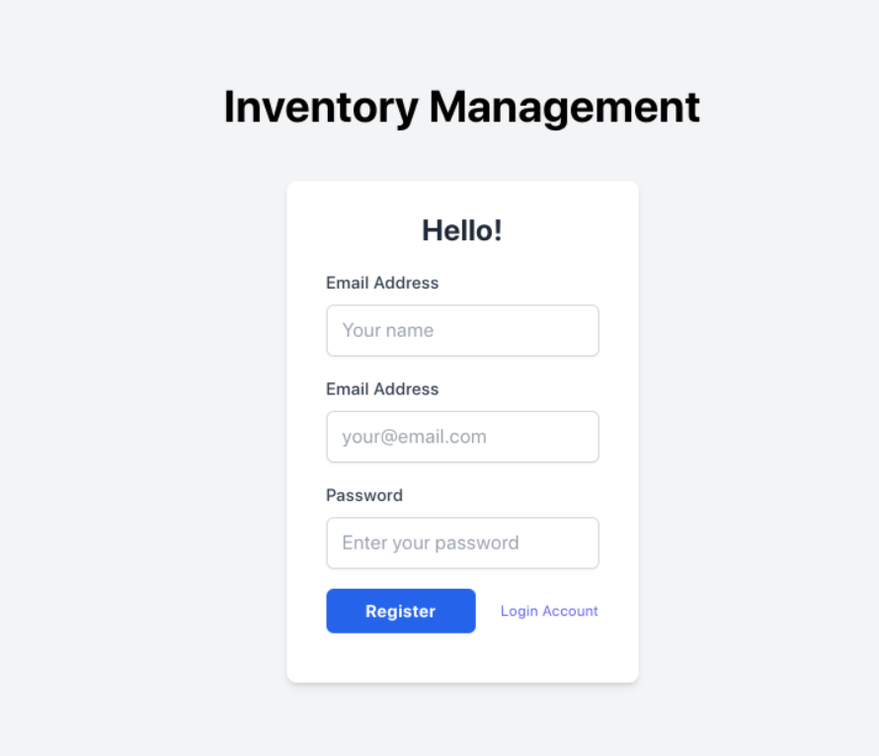
Login & Registration
User Registration
User Login

Slide 5
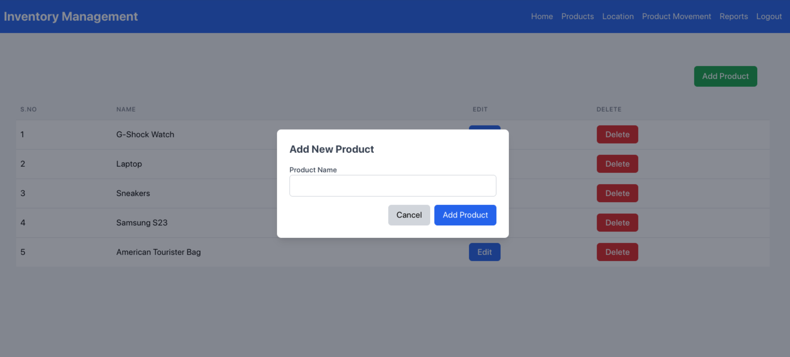
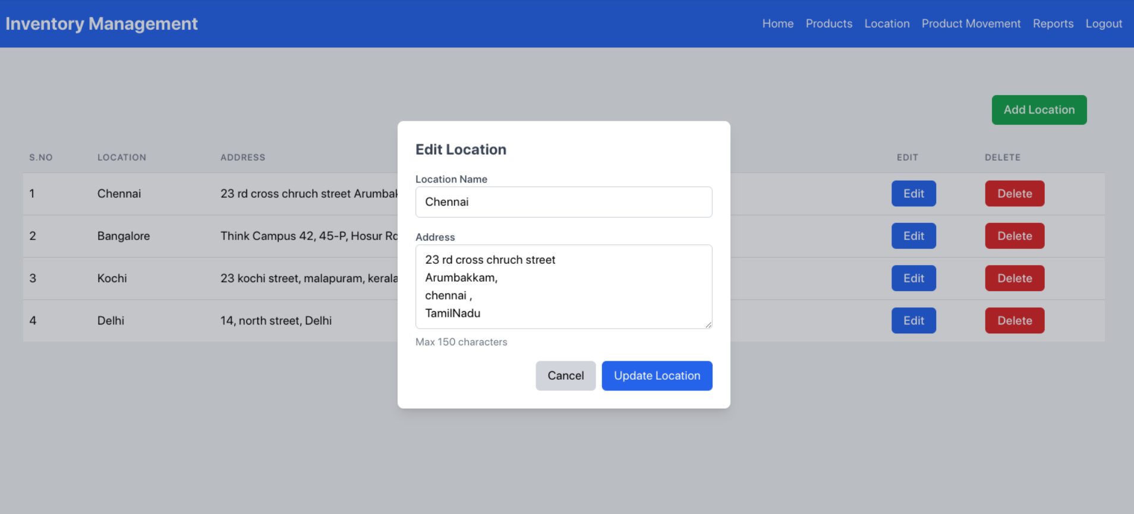
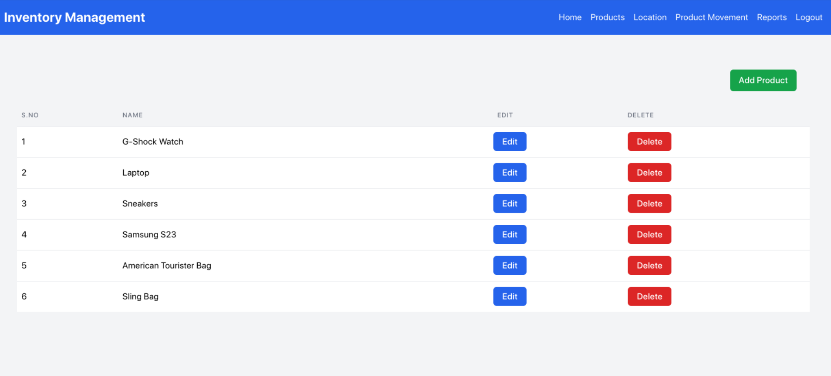
Product
Add Products
Edit Product
View Product

Slide 6
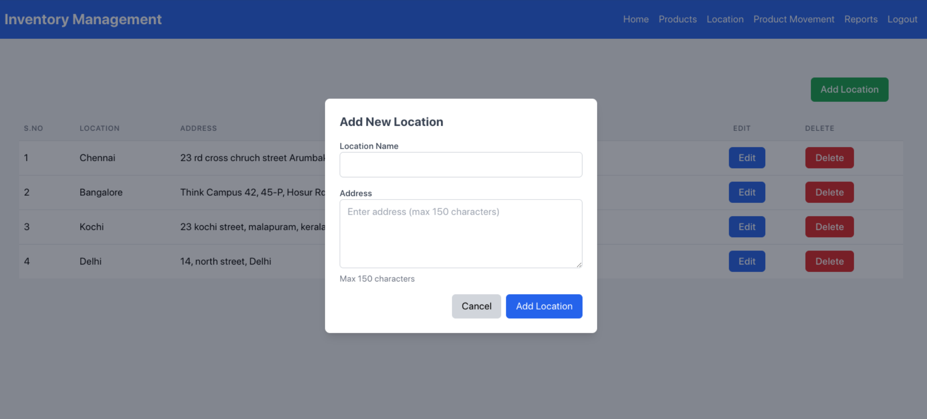
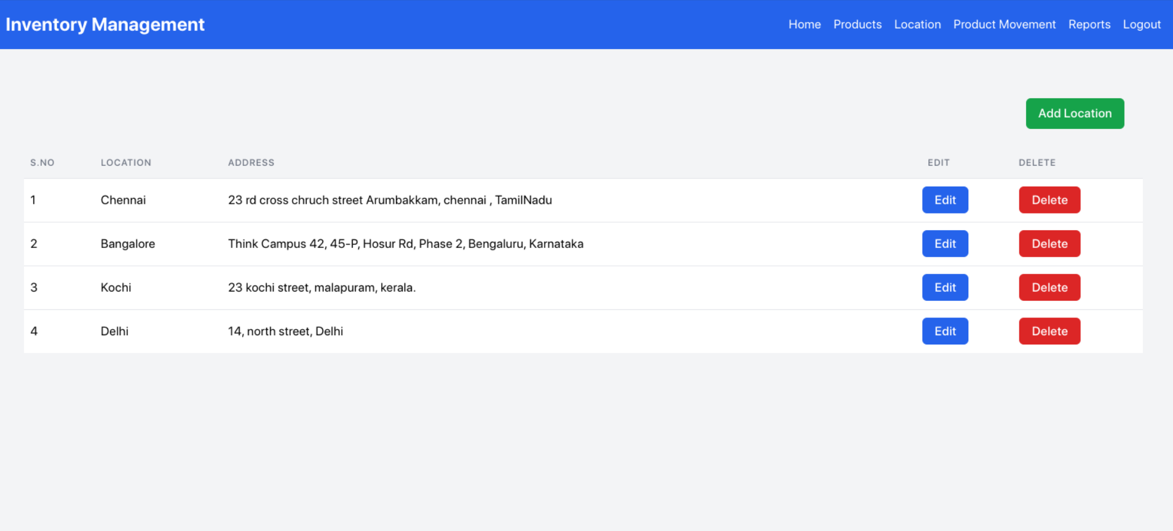
Location
Add Location
Edit Location
View Location

Slide 7
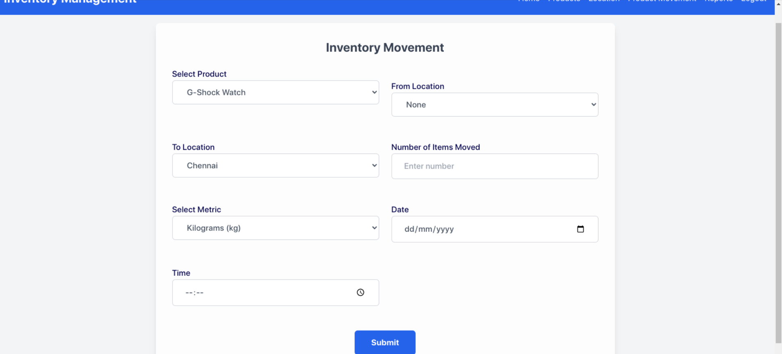
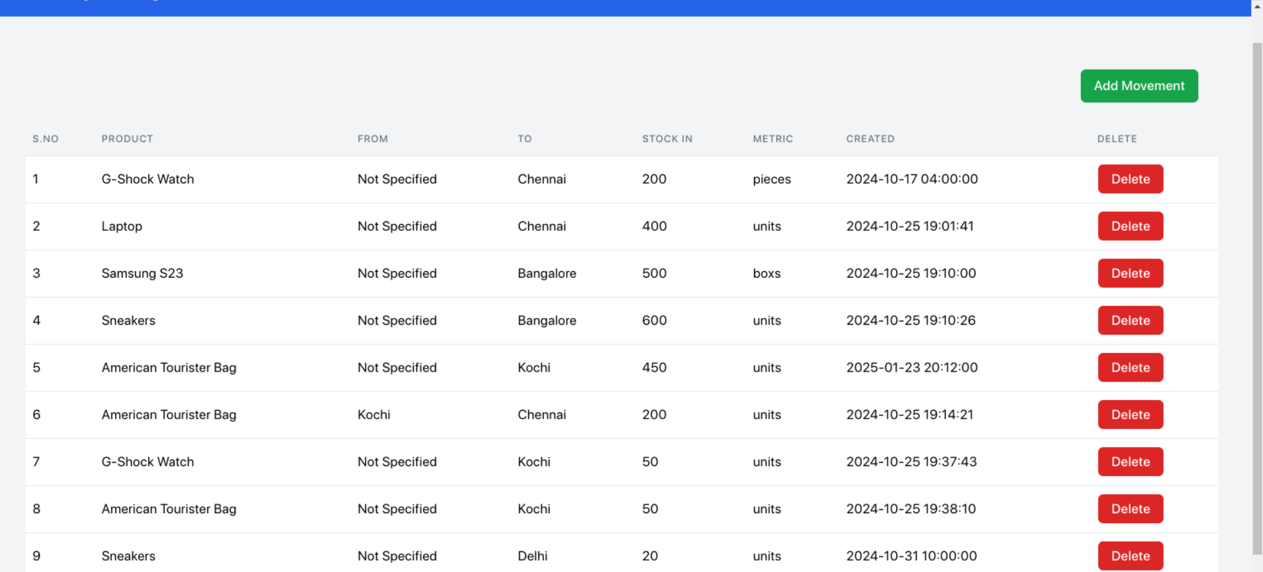
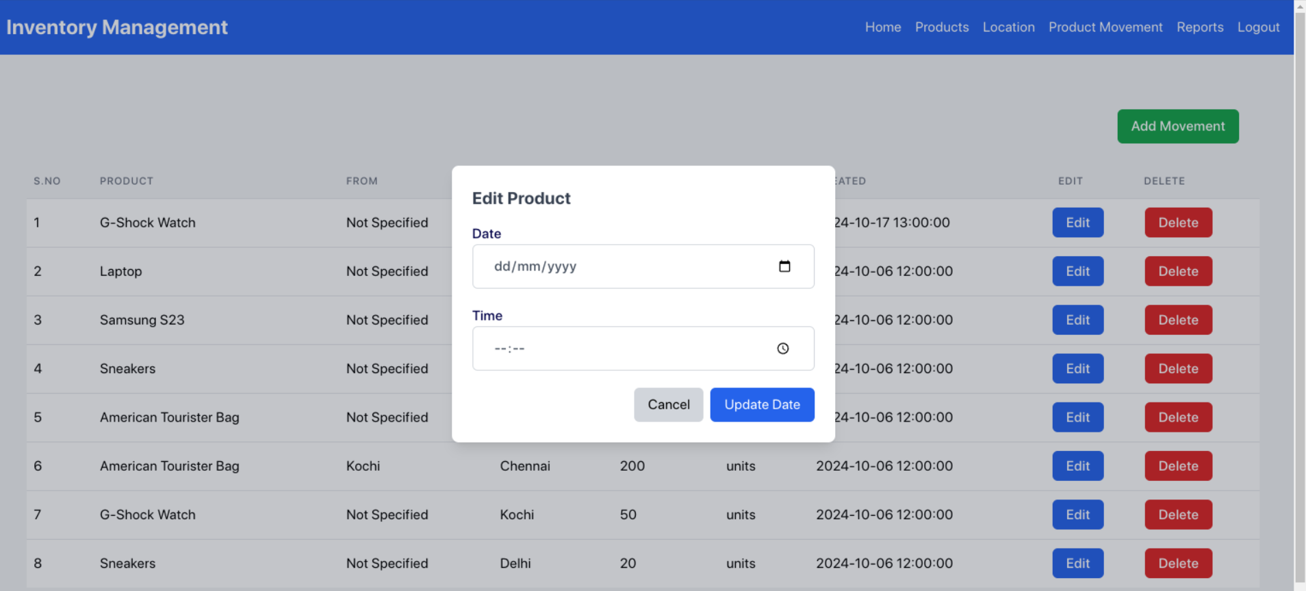
Product Movement
Add Product Movement
View Location
Edit Product

Slide 8
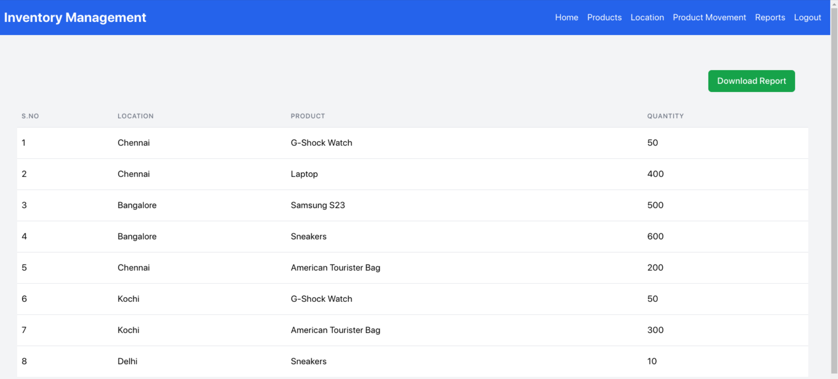
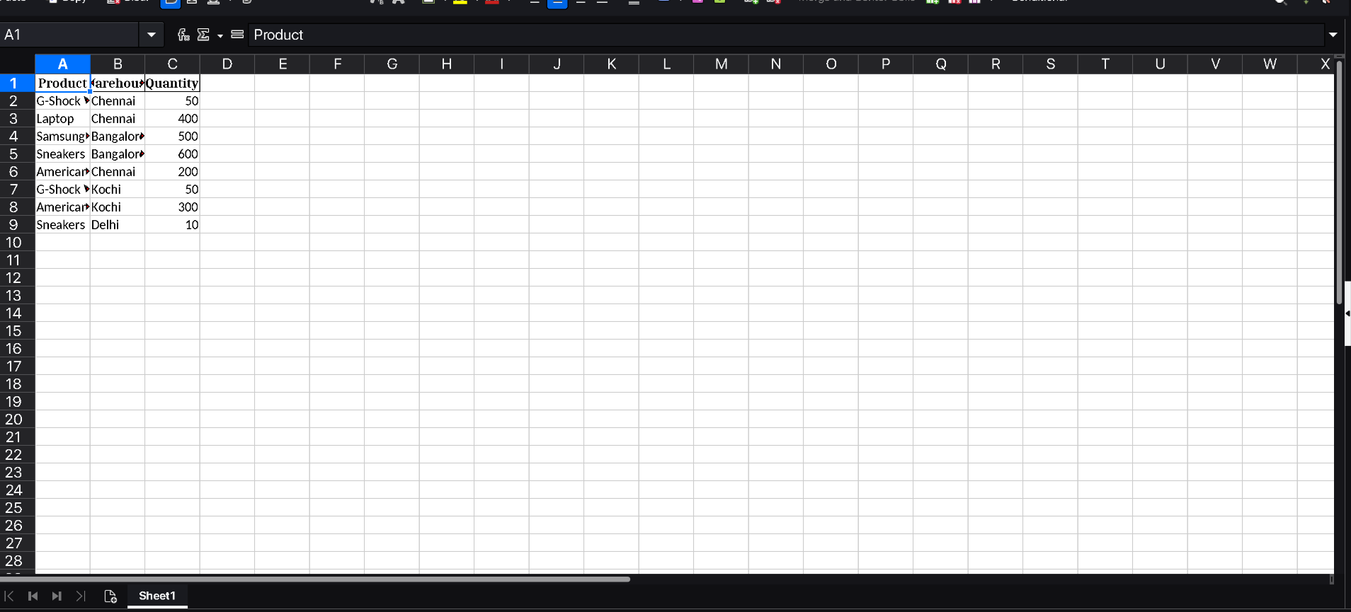
Report
Report View
Report Excel

Slide 9
Technologies Used
Flask: A web framework for Python.
MySQL: The database used to store product and movement data.
Pandas: A Python library used to generate Excel reports.

Slide 10
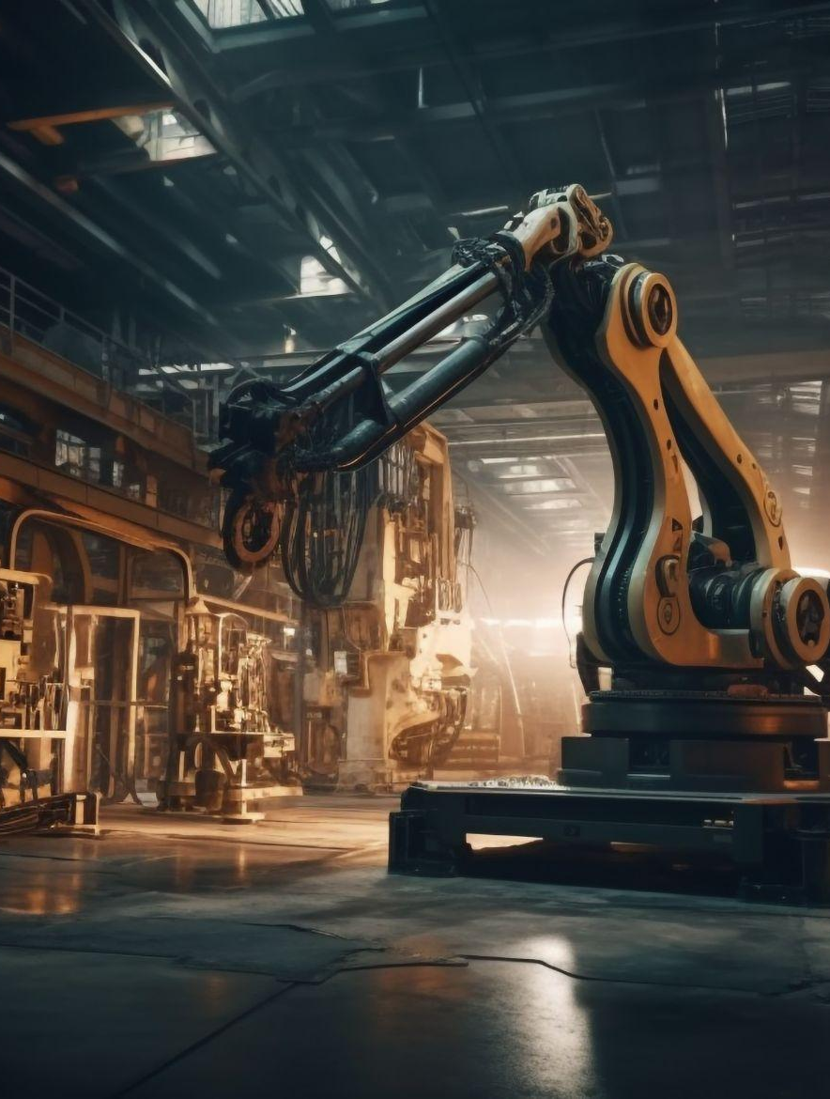
THANKS!
Git Link : https://github.com/kavearhasi/Inventory-Management

